Slide 1
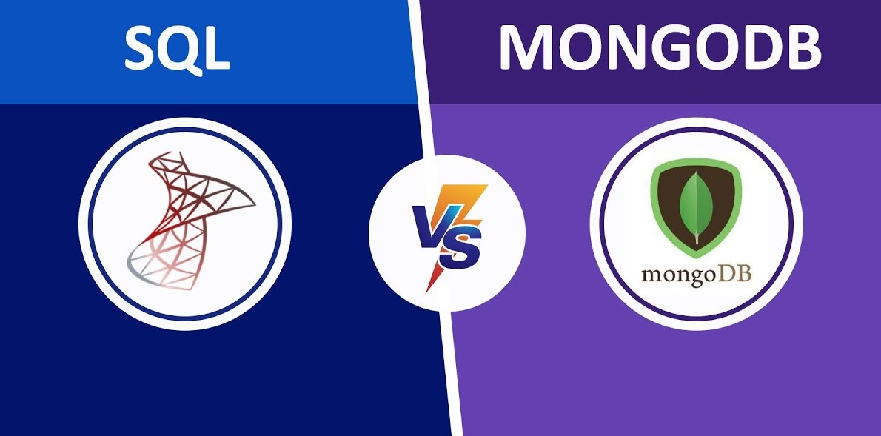
Intro to DB Checkpoint
OMRANI Moôtez belleh

Slide 2
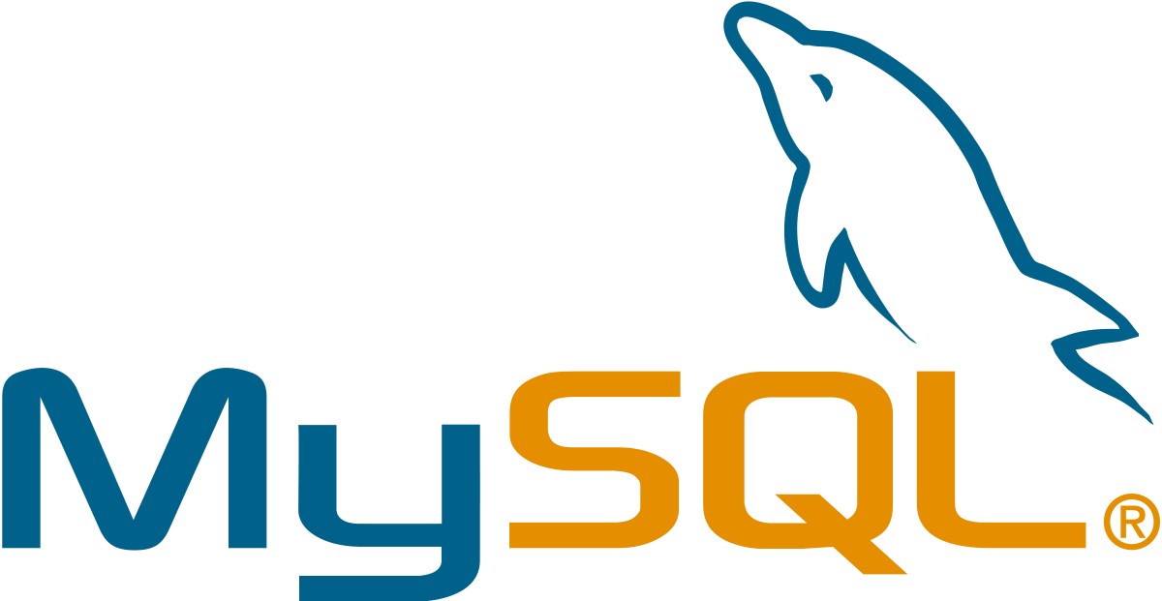
What is MySQL ?
MySQL is the most popular open source SQL database. It is typically used for web application development, and often accessed using PHP.
The main advantages of MySQL are that it is easy to use, inexpensive, reliable (has been around since 1995), and has a large community of developers who can help answer questions.
Some of the disadvantages are that it has been known to suffer from poor performance when scaling, open source development has lagged since Oracle has taken control of MySQL, and it does not include some advanced features that developers may be used to.

Slide 3
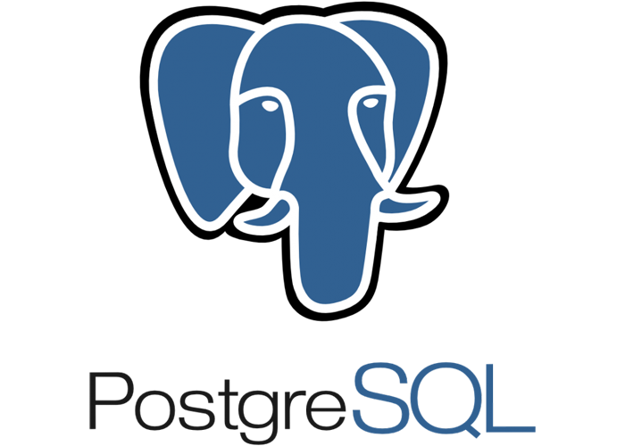
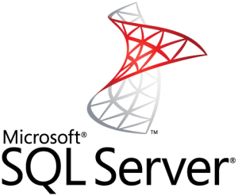
PostgreSQL _ SQL SERVER ?
PostgreSQL is an open source SQL database that is not controlled by any corporation. It is typically used for web application development.
PostgreSQL shares many of the same advantages of MySQL. It is easy to use, inexpensive, reliable and has a large community of developers. It also provides some additional features such as foreign key support without requiring complex configuration.
The main disadvantage of PostgreSQL is that it can be slower in performance than other databases such as MySQL. It is also slightly less popular than MySQL.
Microsoft owns SQL Server. Like Oracle DB, the code is close sourced.
Large enterprise applications mostly use SQL Server.
Microsoft offers a free entry-level version called Express but can become very expensive as you scale your application.

Slide 4
MongoDB
MongoDB is a source-available cross-platform document-oriented database program.
Classified as a NoSQL database program, MongoDB uses JSON-like documents with optional schemas.
MongoDB is developed by MongoDB Inc.
Why is using MongoDB better than using MySQL?
Organizations of all sizes are adopting MongoDB, especially as a cloud database, because it enables them to build applications faster, handle highly diverse data types, and manage applications more efficiently at scale.
Development is simplified as MongoDB documents map naturally to modern, object-oriented programming languages. Using MongoDB removes the complex object-relational mapping (ORM) layer that translates objects in code to relational tables. MongoDB’s flexible data model also means that your database schema can evolve with business requirements. MySQL's rigid relational structure adds overhead to applications and slows developers down as they must adapt objects in code to a relational structure.

Slide 5
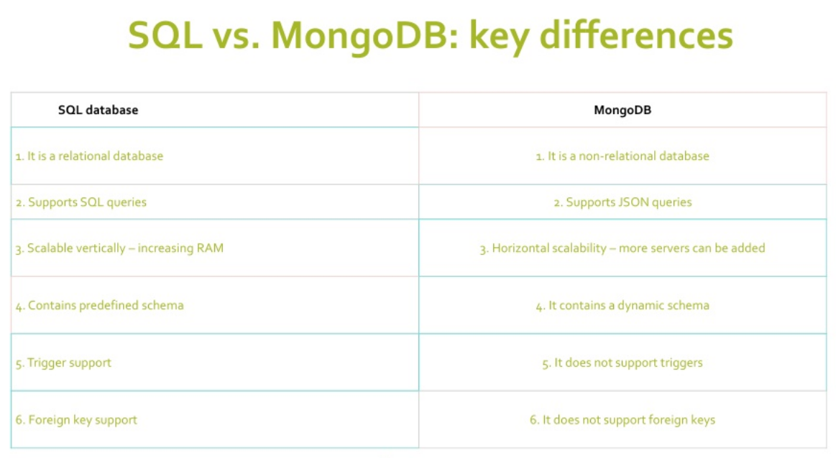
A comparison between SQL / MongoDB

